Slide 1
Smart Solutions For Railways
Presented by
Sandeep I
Boopathi S
Anbazhagan E
Karthik M

Slide 2
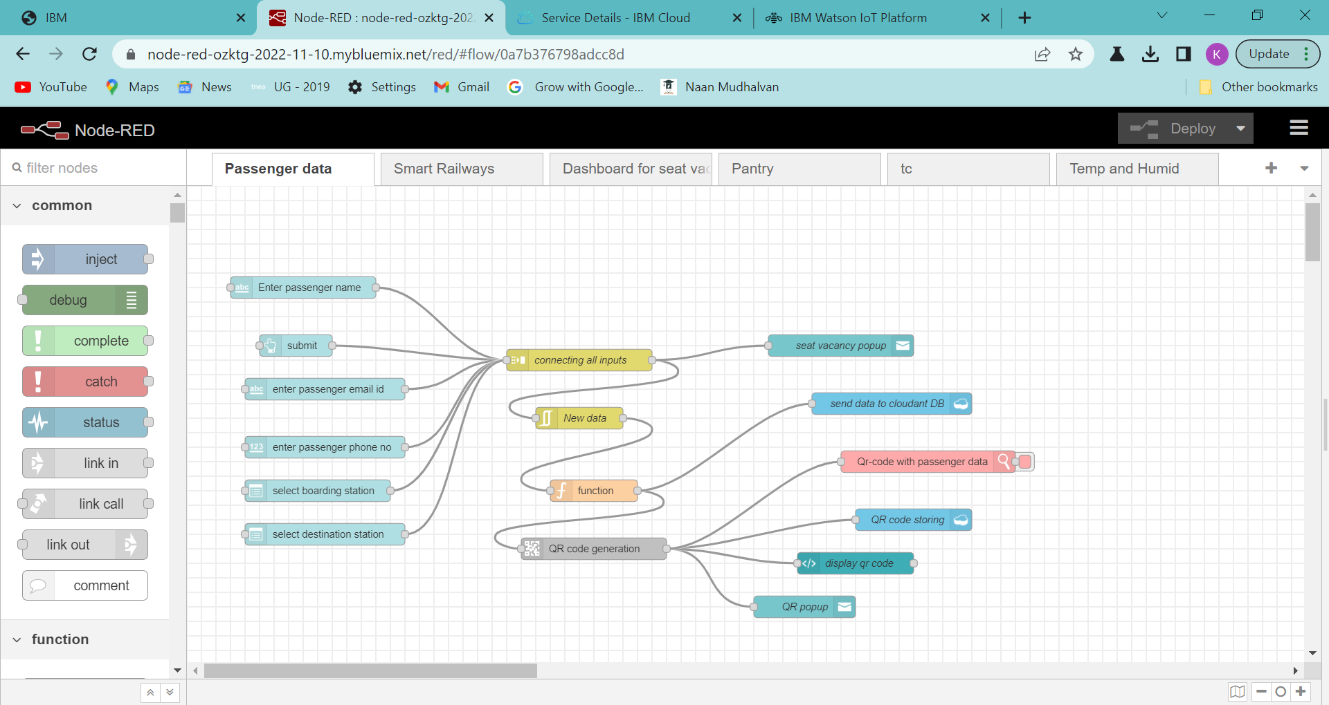
Passenger Data

Slide 3
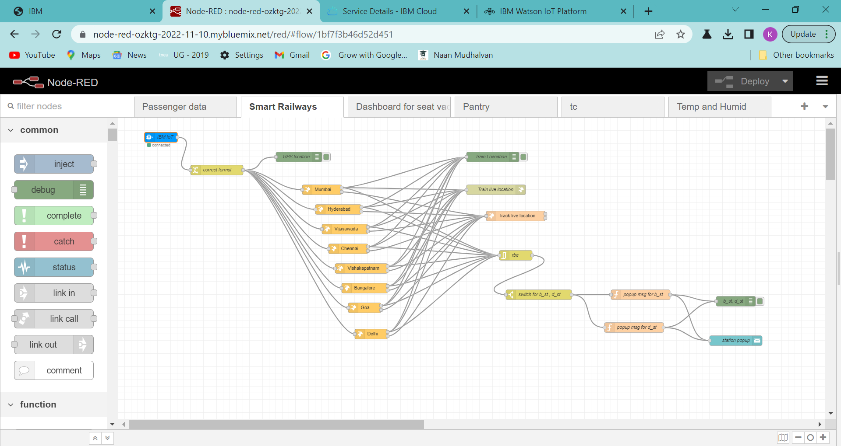
Smart Solutions

Slide 4
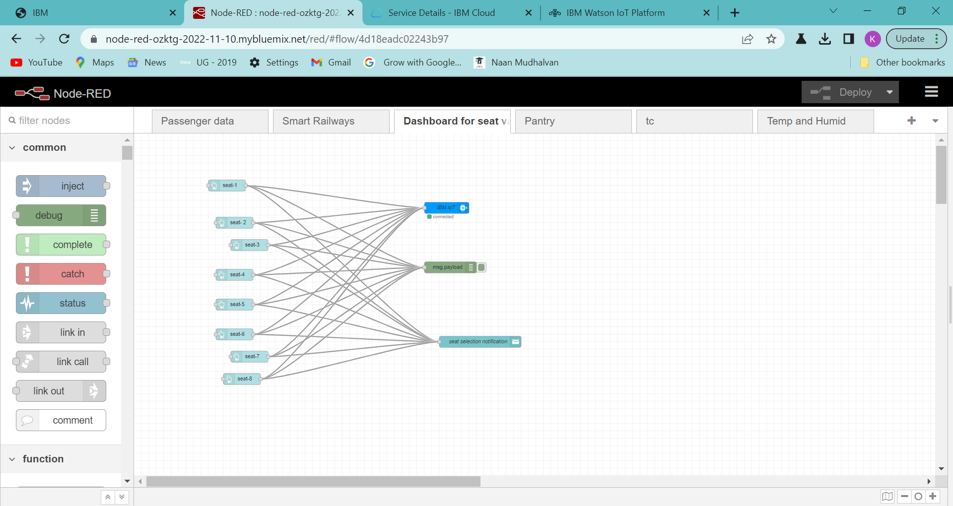
Dashboard for seat vacancy

Slide 5
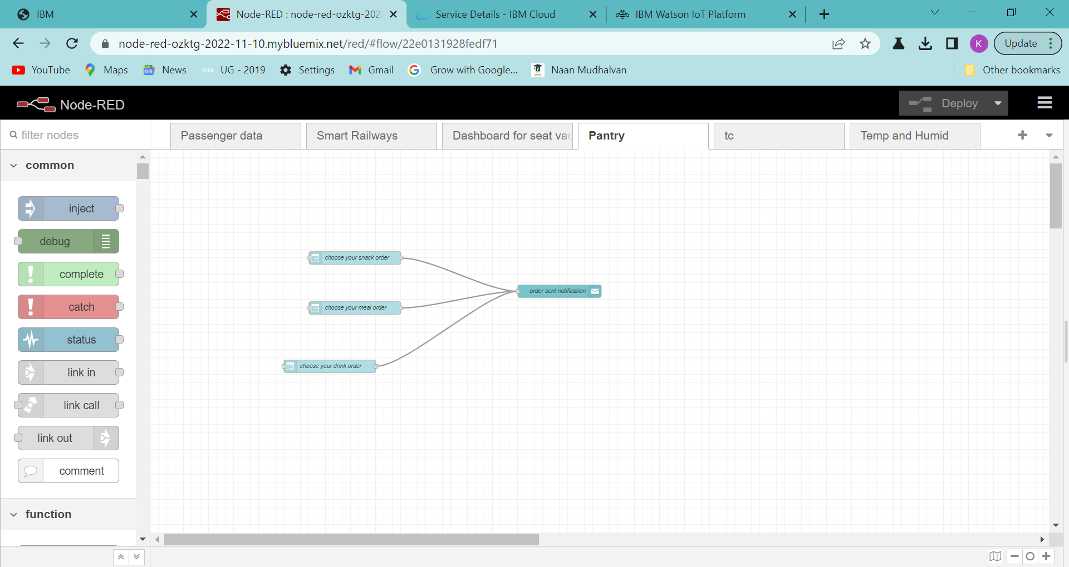
Pantry

Slide 6
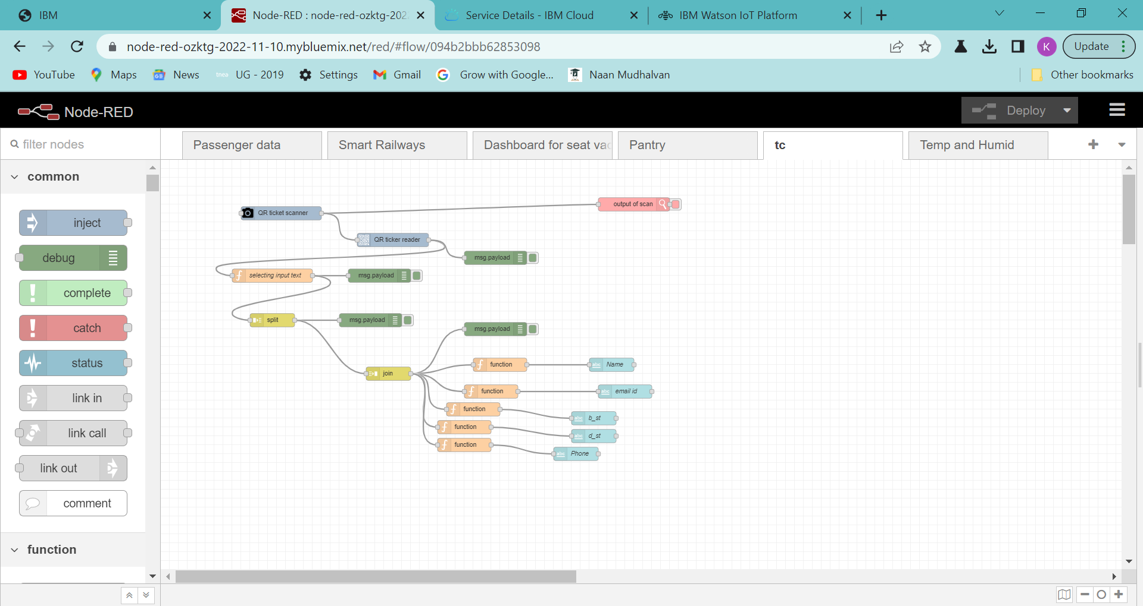
TC

Slide 7
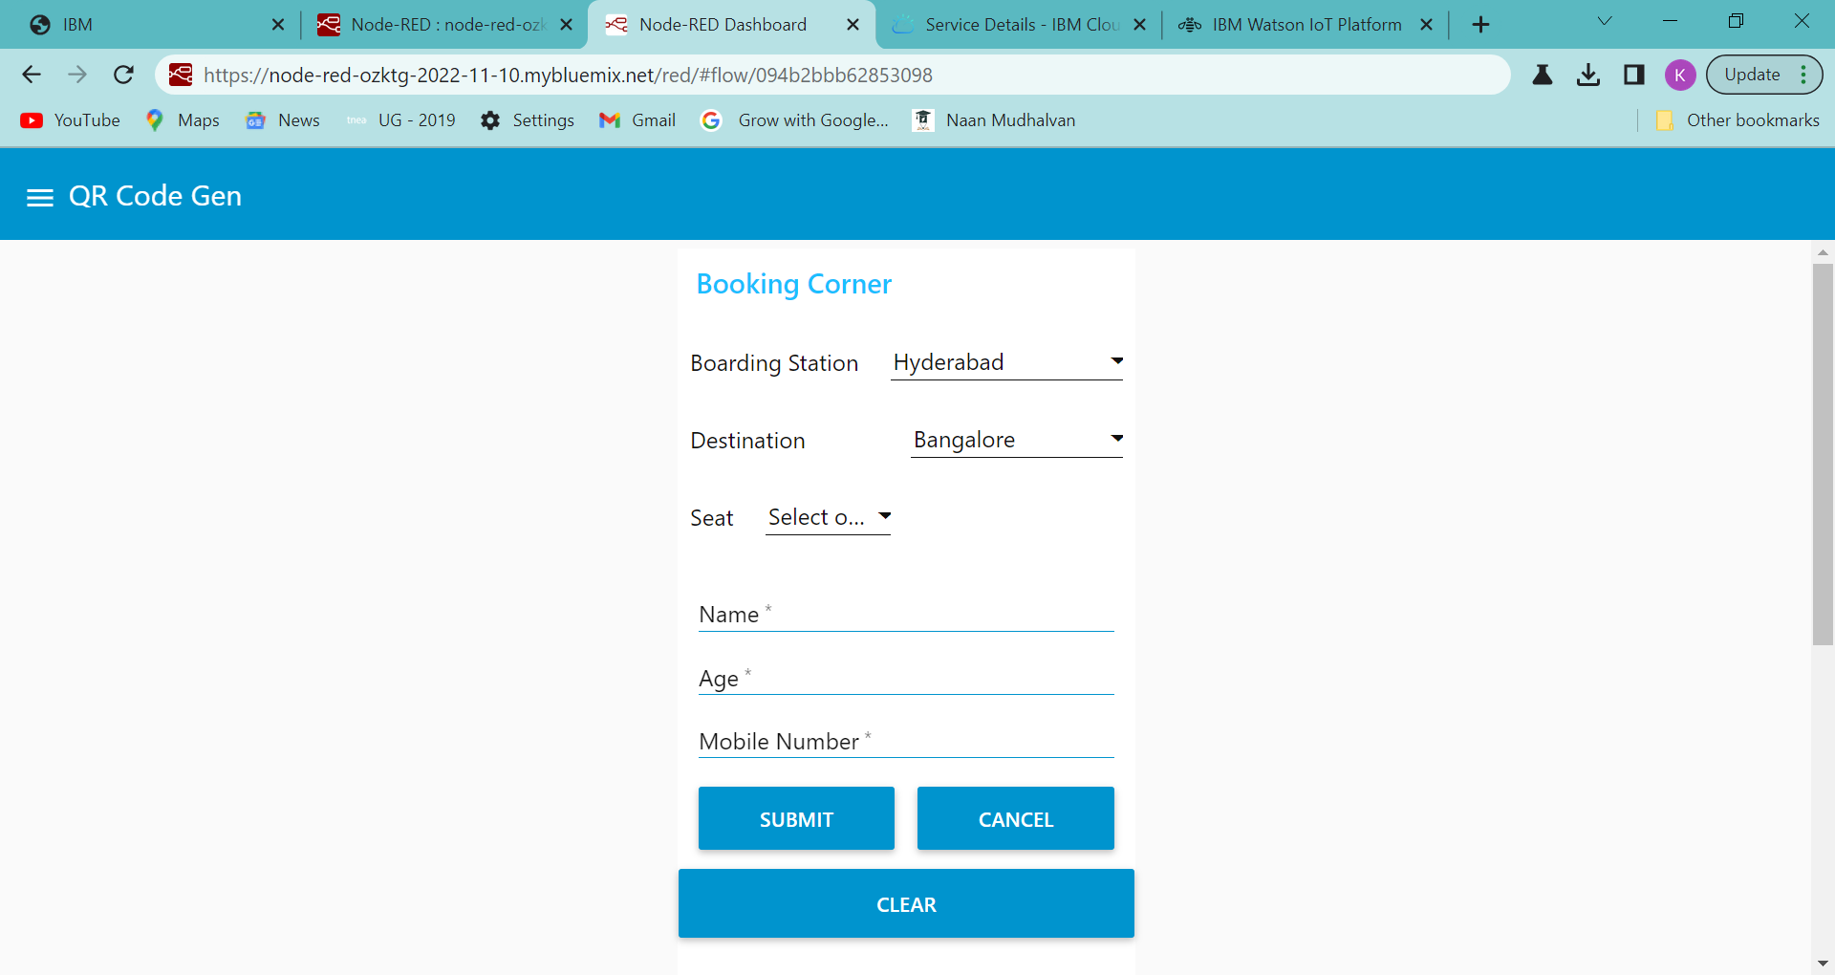
Ticket Generation

Slide 8
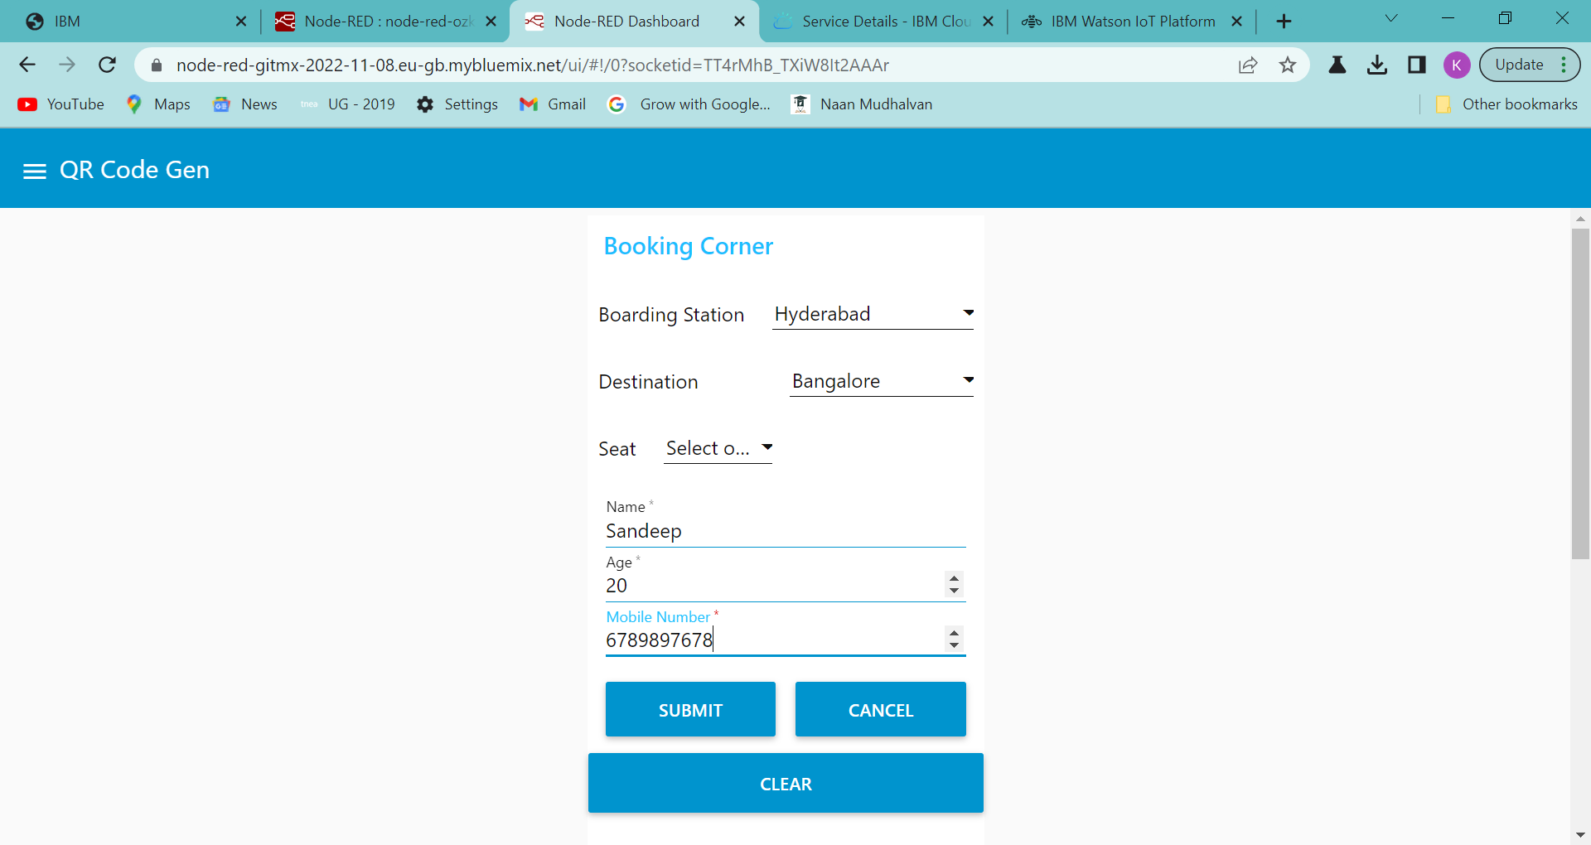

Slide 9
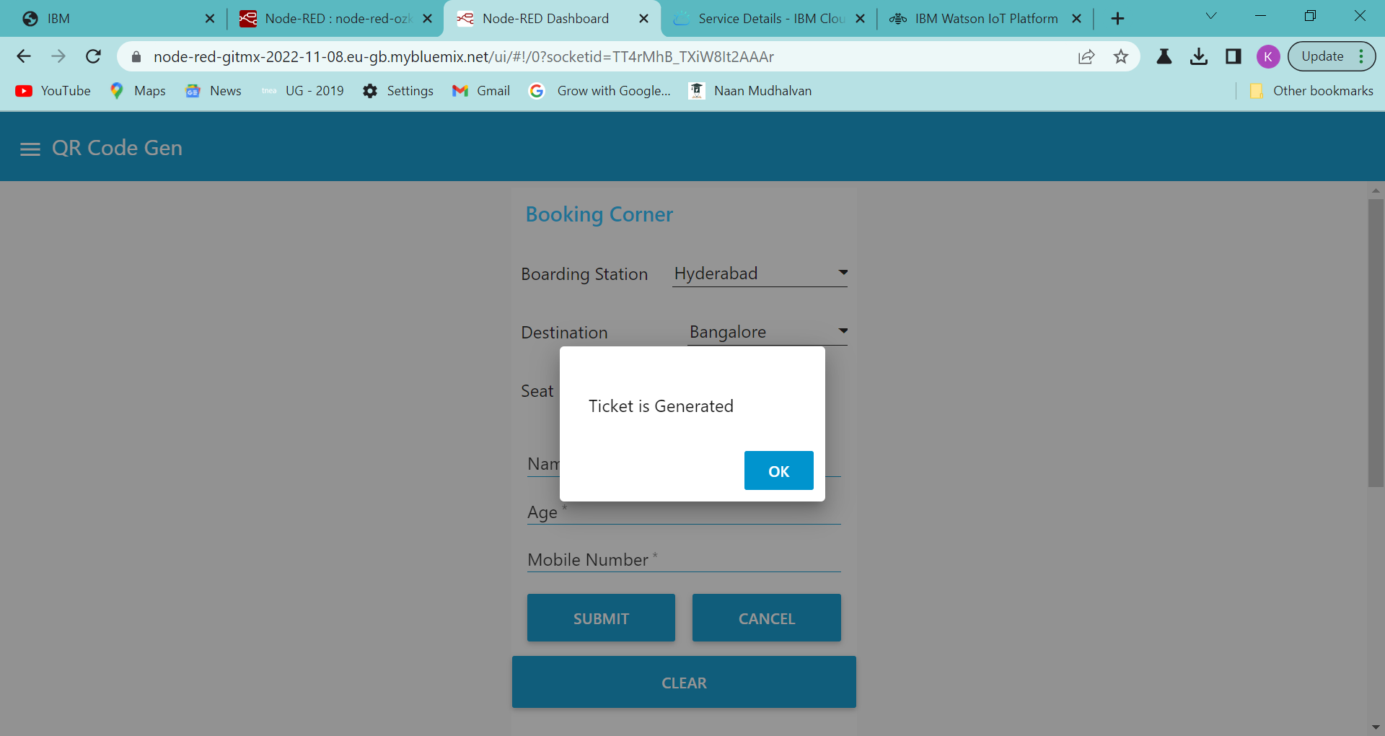
Meetings

Slide 10
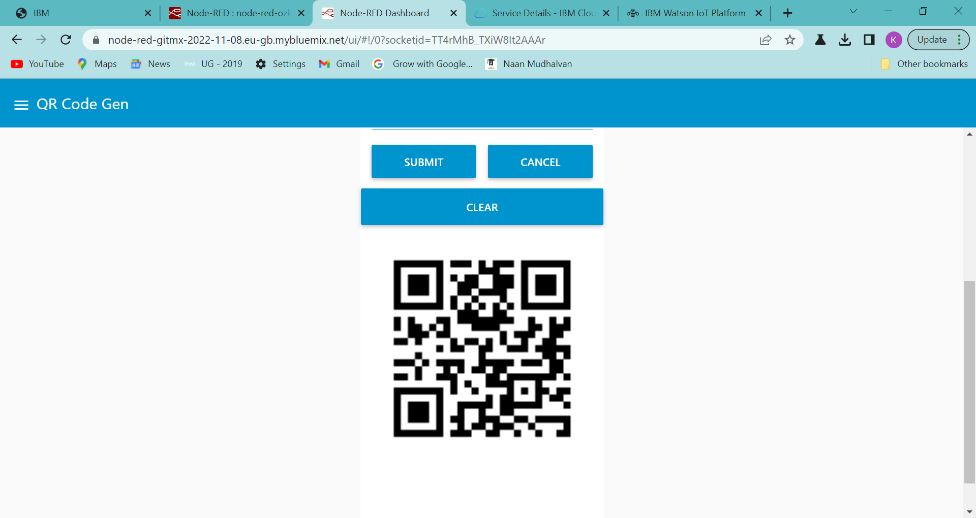
QR Code

Slide 11
_________________
THANK YOU!

